Slide 1
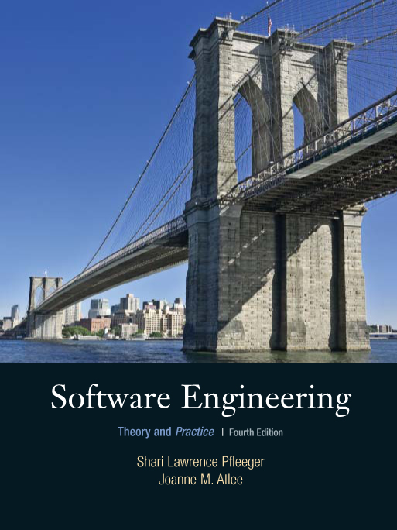
Writing the Programs
Shari L. Pfleeger
Joann M. Atlee
4th Edition

Slide 2
Contents
7.1 Programming Standards and Procedures
7.2 Programming Guidelines
7.3 Documentation
7.4 The Programming Process
7.5 Information System Example
7.6 Real Time Example
7.7 What this Chapter Means for You

Slide 3
Chapter 7 Objectives
Standards for programming
Guidelines for reuse
Using design to frame the code
Internal and external documentation

Slide 4
Programming as a Challenging Task
All detailed issues have not been addressed
Structures and Relationships that are easy to draw may not be straightforward to program
Code understandable for others
Benefit from characteristics of design as well as keeping the code reusable

Slide 5
7.1 Programming Standards and Procedures
Standards for you
methods of code documentation
Standards for others
Integrators, maintainers, testers
Prologue documentation
Automated tools to identify dependencies
Matching design with implementation
Changes in design can be easily implemented in code
Carry forward the design’s modularity

Slide 6
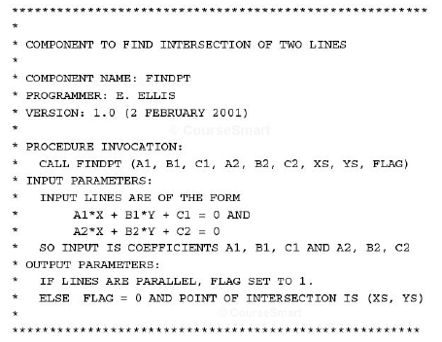
7.1 Programming Standards and Procedures Prologue Documentation

Slide 7
7.2 Programming Guidelines Control Structures
Make the code easy to read
Reader should not worry about understanding the control flow
Reflect the design’s control structure

Slide 8
7.2 Programming Guidelines Example of Control Structures
Control skips around among the program’s statements
benefit = minimum;
if (age < 75) goto A;//may be a function call
benefit = maximum;
goto C;
if (AGE < 65) goto B;
if (AGE < 55) goto C;
A: if (AGE < 65) goto B;
benefit = benefit * 1.5 + bonus;
goto C;
B: if (age < 55) goto C;
benefit = benefit * 1.5;
C: next statement
Rearrange the code
if (age < 55) benefit = minimum;
elseif (AGE < 65) benefit = minimum + bonus;
elseif (AGE < 75) benefit = minimum * 1.5 + bonus;
else benefit = maximum;
Restructuring

Slide 9

7.2 Programming Guidelines Control Structures
Make the code not too specific, and not too general
Specific enough to be understood, generic enough to be re-used
Use parameter names and comments to exhibit coupling among components
Make the dependency among components visible

Slide 10
7.2 Programming Guidelines Algorithms
Common objective and concern: performance (speed)/execution time
Efficiency may have hidden costs
cost to write the faster code
cost to test the code
cost to understand the code
cost to modify the code
Do not sacrifice clarity and correctness for speed
Learn compiler’s way of optimization

Slide 11
7.2 Programming Guidelines Data Structures
Several techniques that used the structure of data to organize the program
keeping the program simple
using a data structure to determine a program structure

Slide 12
7.2 Programming Guidelines Keep the Program Simple Example: Determining Federal Income Tax
For the first $10,000 of income, the tax is 10%
For the next $10,000 of income above $10,000, the tax is 12 percent
For the next $10,000 of income above $20,000, the tax is 15 percent
For the next $10,000 of income above $30,000, the tax is 18 percent
For any income above $40,000, the tax is 20 percent
tax = 0.
if (taxable_income == 0) goto EXIT;
if (taxable_income > 10000) tax = tax + 1000;
else{
tax = tax + .10*taxable_income;
goto EXIT;
}
if (taxable_income > 20000) tax = tax + 1200;
else{
tax = tax + .12*(taxable_income-10000):
goto EXIT;
}
if (taxable_income > 30000) tax = tax + 1500;
else{
tax = tax + .15*(taxable_income-20000);
goto EXIT;
}
if (taxable_income < 40000){
tax = tax + .18*(taxable_income-30000);
goto EXIT;
}
else
tax = tax + 1800. + .20*(taxable_income-40000);
EXIT;

Slide 13
7.2 Programming Guidelines Keep the Program Simple Example (continued)
Define a tax table for each “bracket” of tax liability
Simplified algorithm
for (int i=2, level=1; i <= 5; i++)
if (taxable_icome > bracket[i])
level = level + 1;
tax= base[level]+percent[level] * (taxable_income - bracket[level]);
Bracket | Base | Percent
0 | 0 | 10
10,000 | 1000 | 12
20,000 | 2200 | 15
30,000 | 3700 | 18
40,000 | 5500 | 20

Slide 14
7.2 Programming Guidelines General Guidelines to Preserve Quality
Employ pseudocode
Revise and rewrite, rather than patch
Convoluted control flow
Decision process hard to understand
Unconditional branches difficult to eliminate
Reuse
Producer reuse: create components designed to be reused in future applications
Consumer reuse: reuse components initially developed for other projects
Refactoring and Restructuring

Slide 15
7.2 Programming Guidelines Consumer Reuse
Four key characteristics to check about components to reuse
does the component perform the function or provide the data needed?
is it less modification than building the component from scratch?
is the component well-documented?
is there a complete record of the component’s test and revision history?

Slide 16
7.2 Programming Guidelines Producer Reuse
Several issues to keep in mind
make the components general
separate dependencies (to isolate sections likely to change)
keep the component interface general and well-defined
include information about any faults found and fixed
use clear naming conventions
document data structures and algorithms
keep the communication and error-handling sections separate and easy to modify

Slide 17
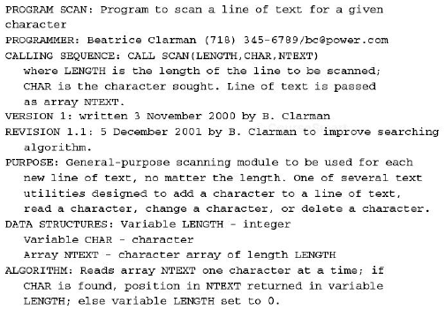
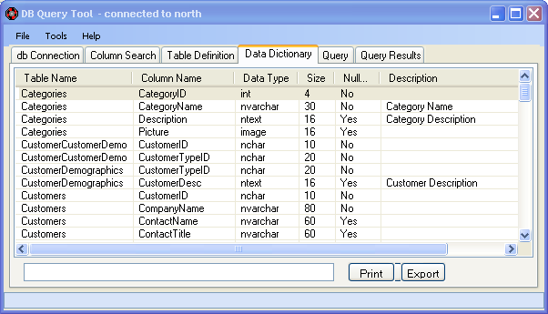
7.3 Documentation
Internal documentation
header comment block
meaningful variable names and statement labels
other program comments
format to enhance understanding
document data (data dictionary)

Slide 18
7.3 Documentation Information Included in Header Comment Block
What is the component called
Who wrote the component
Where the component fits in the general system design
When the component was written and revised
Why the component exists
How the component uses its data structures, algorithms, and control

Slide 19
7.3 Documentation
External documentation
describe the problem
describe the algorithm
describe the data

Slide 20
7.4 The Programming Process
Documentation is still essential in agile-methods
Assists the developers in planning, as a roadmap
Helps describe key abstractions and defines system boundaries
Assists in communicating among team members

Slide 21
7.5 Information System Example Piccadilly System
Design Description
Input: Opposition schedule
For each Television company name, create Opposition company.
For each Opposition schedule,
Locate the Episode where Episode schedule date = Opposition transmission date AND
Episode start time = Opposition transmission time
Create instance of Opposition program
Create the relationships Planning and Competing
Output: List of Opposition programs
Data dictionary description
Opposition schedule = * Data flow *
Television company name
+ {Opposition transmission date
+ Opposition transmission time + Opposition program name
+ (Opposition predicted rating)}

Slide 22
7.5 Information System Example Piccadilly System’s Implementation
Passing by value
void Match:: calv(Episode episode_start_time)
{
first_advert = episode_start_time + increment;
// The system makes a copy of Episode
// and your program can use the values directly.
}
Passing by pointer
void Match:: calp(Episode* episode)
{
episode->setStart (episode->getStart());
// This example passes a pointer to an instance of Episode.
// Then the routine can invoke the services (such as setStart
// and getStart) of Episode using the -> operator.
}
Passing by reference
void Match:: calr(Episode& episode)
{
episode.setStart (episode.getStart());
// This example passes the address of Episode.
// Then the routine can invoke the services (such as setStart
// and getStart) of Episode using the . operator.
}

Slide 23
7.6 Real-Time Example Ariane-5
Should have included an exception handler
try {
}
catch (…..) {
//attempt to patch up state
//either satisfy postcondition or raise exception again
}

Slide 24
7.7 What This Chapter Means for You
Things to consider when writing a code
organizational standards and guidelines
reusing code from other projects
writing code to make it reusable on future projects
using the low-level design as an initial framework, and moving in several iterations from design to code

Slide 25
Disclaimer
Minor modifications have been made in content and flow of UCF slides

